Slide 1


GROUP 2A
CAMPUS CONNECT: A WEB-BASED PLATFORM
FOR MONITORING FACULTY-STUDENT
ENGAGEMENT
TARLAC STATE UNIVERSITY

Slide 2


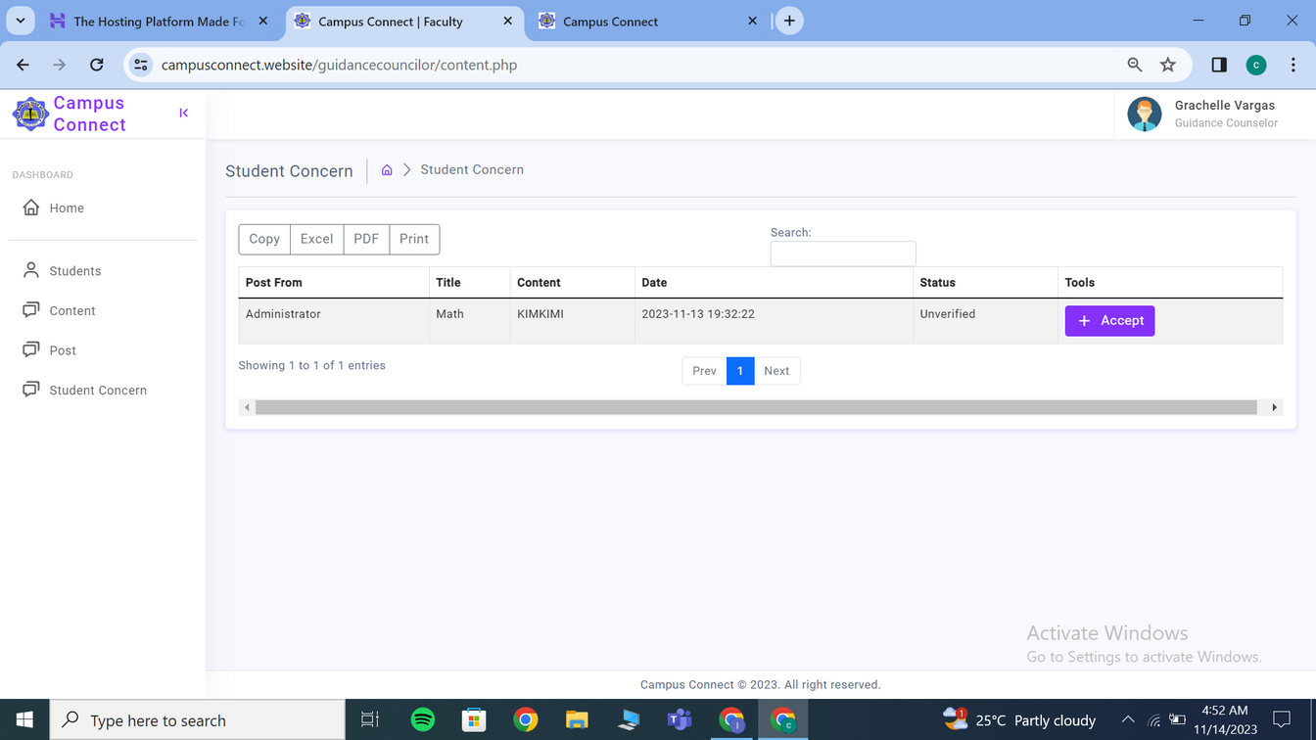

RECOMMENDATIONS
CHAPTER 1
KDF - Under objectives, instructor module - moderation of contents
OBJECTIVES
RESULT AND DISCUSSION
CONCLUSION
METHODOLOGY
Campus Connect: A Web-based Platform for Monitoring Faculty-Student Engagement

Slide 3
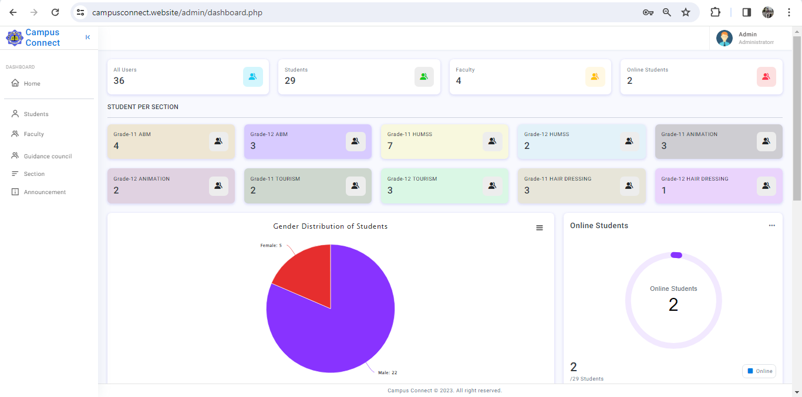
RECOMMENDATIONS
CHAPTER 1
XJPA - Specify what will be monitored in the objectives
OBJECTIVES
RESULT AND DISCUSSION
CONCLUSION
METHODOLOGY
Campus Connect: A Web-based Platform for Monitoring Faculty-Student Engagement

Slide 4
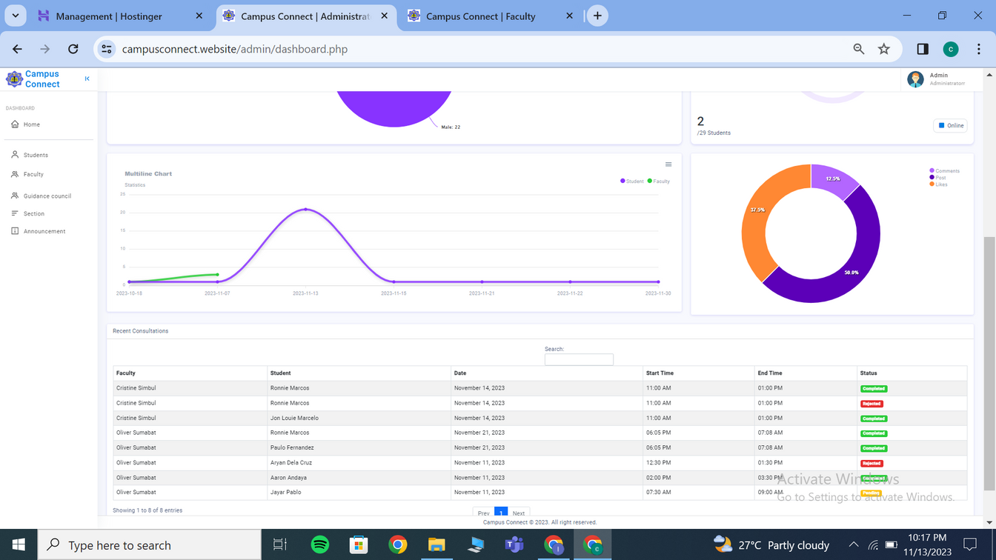
RECOMMENDATIONS
CHAPTER 1
XJPA - Specify what will be monitored in the objectives
OBJECTIVES
RESULT AND DISCUSSION
CONCLUSION
METHODOLOGY
Campus Connect: A Web-based Platform for Monitoring Faculty-Student Engagement

Slide 5
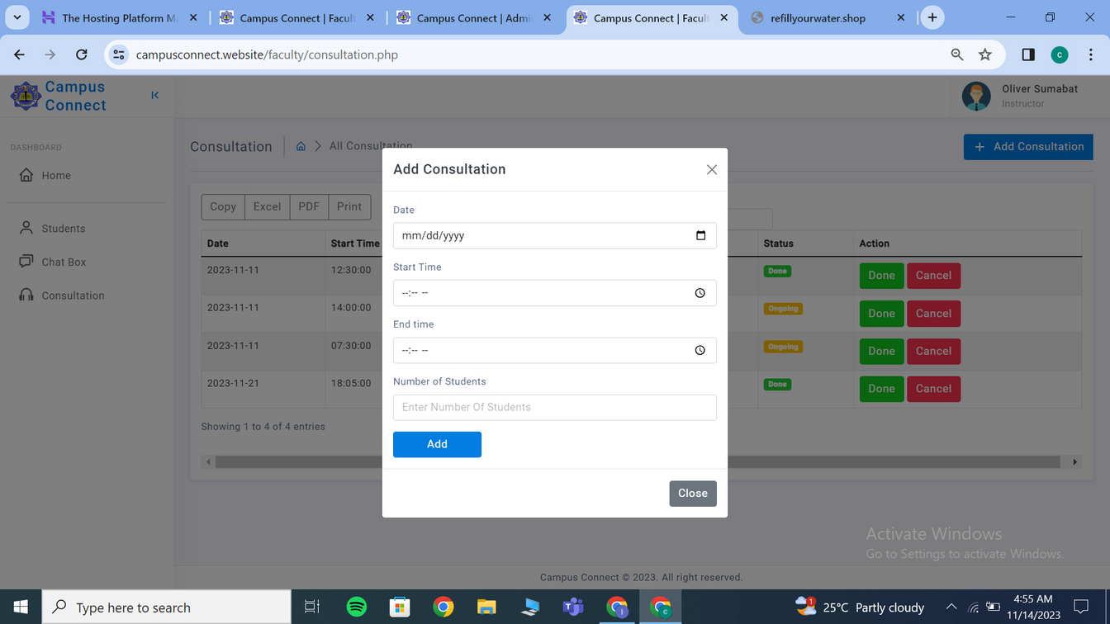
RECOMMENDATIONS
CHAPTER 1
XJPA - Specify minimum and maximum slot and hours in the consultation.
OBJECTIVES
RESULT AND DISCUSSION
CONCLUSION
METHODOLOGY
Campus Connect: A Web-based Platform for Monitoring Faculty-Student Engagement

Slide 6
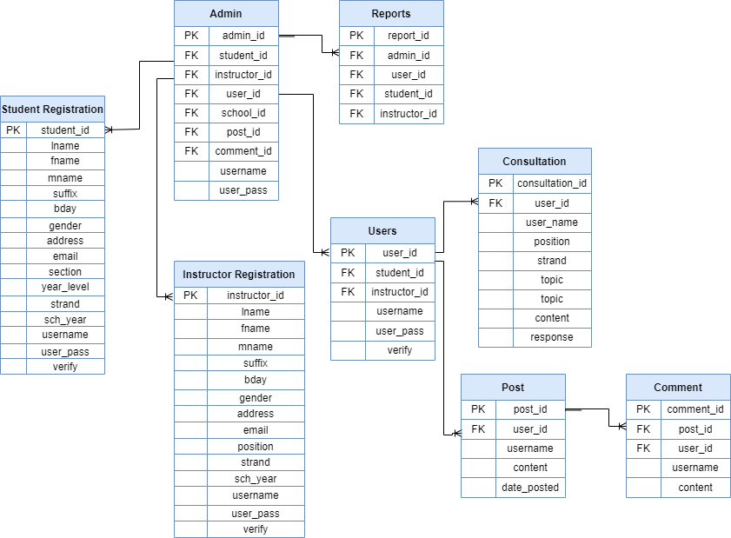
CHAPTER 4
RECOMMENDATIONS
XJPA - ERD: Include appointment subject consultation
XJPA - ERD: Remove report, put consultation schedule time, day and student subject for the consultation.
XJPA - ERD: Re arranging diagrams
OBJECTIVES
RESULT AND DISCUSSION
CONCLUSION
time
METHODOLOGY
Campus Connect: A Web-based Platform for Monitoring Faculty-Student Engagement

Slide 7
RECOMMENDATIONS
OBJECTIVES
OBJECTIVES
1. To design and develop a Web-based Engagement Monitoring System for Faculty and Students incorporating the following features.
RESULT AND DISCUSSION
CONCLUSION
METHODOLOGY
Campus Connect: A Web-based Platform for Monitoring Faculty-Student Engagement

Slide 8
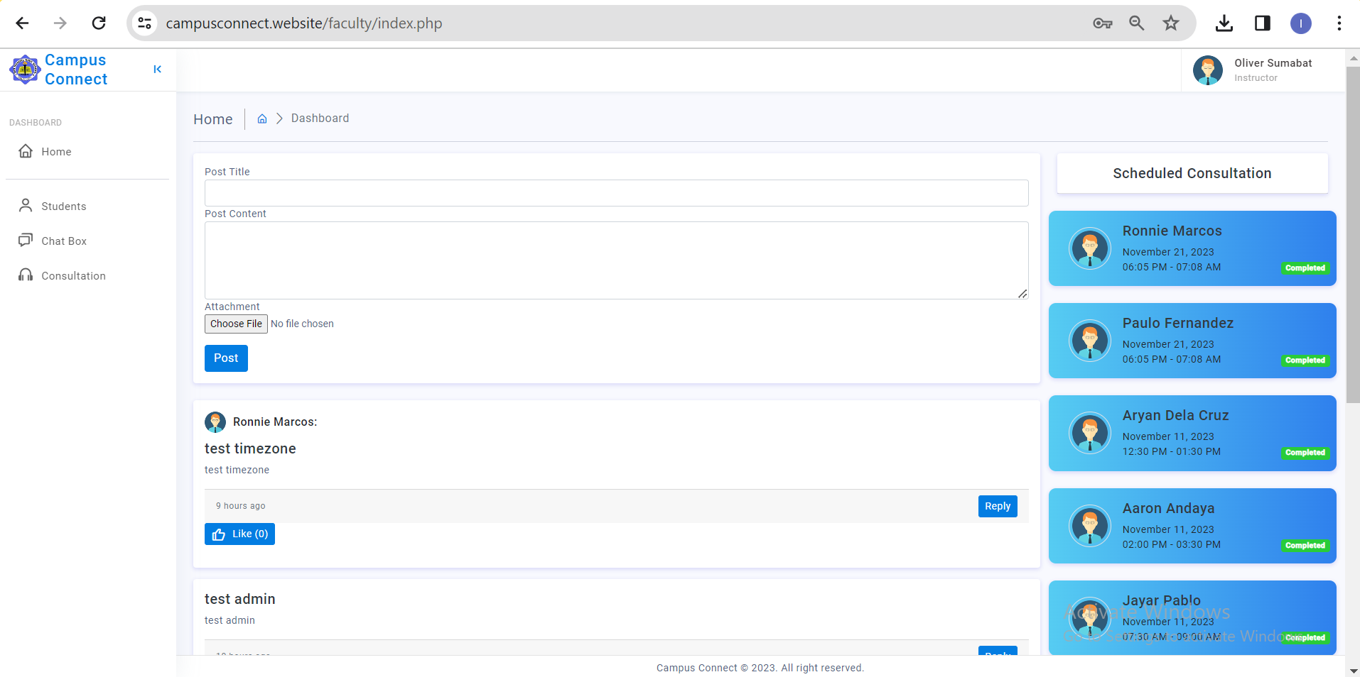
1Instructor Perspective
1.1.1Instructors’ Dashboard
RECOMMENDATIONS
OBJECTIVES
RESULT AND DISCUSSION
CONCLUSION
METHODOLOGY
Campus Connect: A Web-based Platform for Monitoring Faculty-Student Engagement

Slide 9
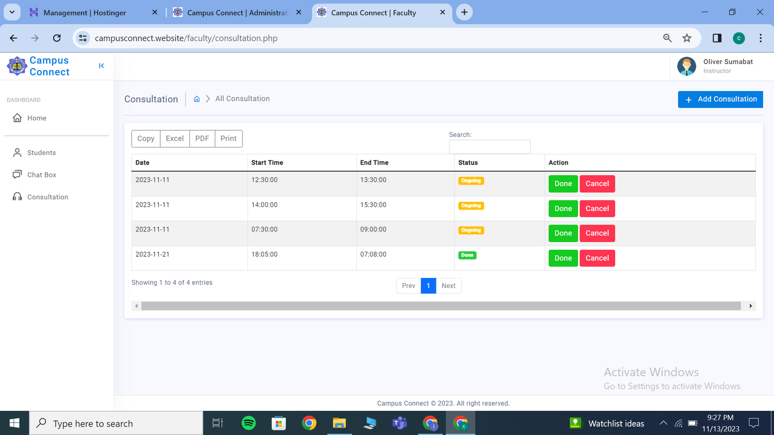
1.1.2Manage Students Consultation
RECOMMENDATIONS
OBJECTIVES
RESULT AND DISCUSSION
CONCLUSION
METHODOLOGY
Campus Connect: A Web-based Platform for Monitoring Faculty-Student Engagement

Slide 10
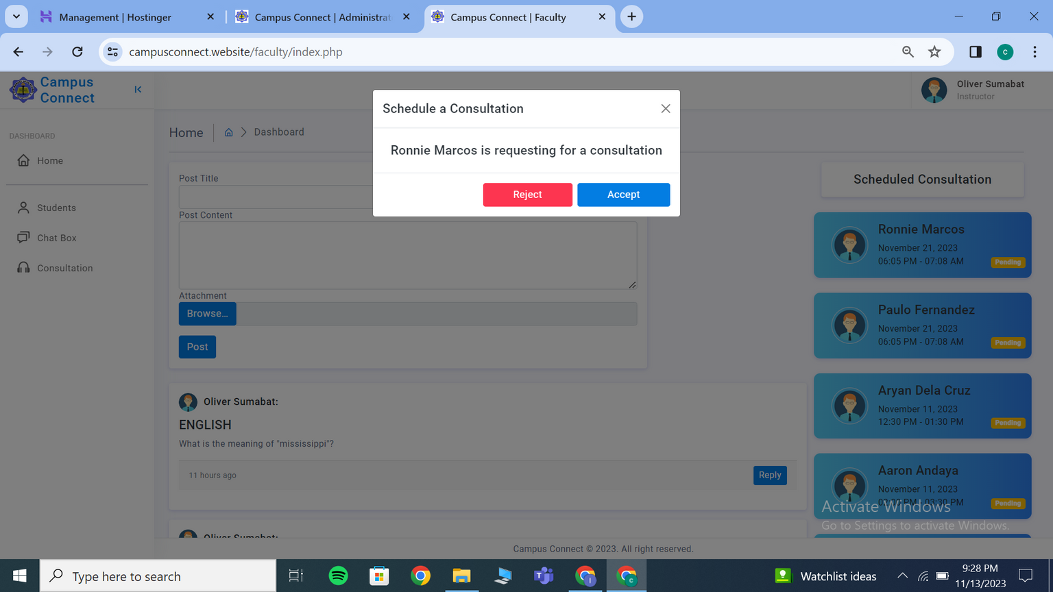
1.1.2Manage Students Consultation
RECOMMENDATIONS
OBJECTIVES
RESULT AND DISCUSSION
CONCLUSION
METHODOLOGY
Campus Connect: A Web-based Platform for Monitoring Faculty-Student Engagement

Slide 11
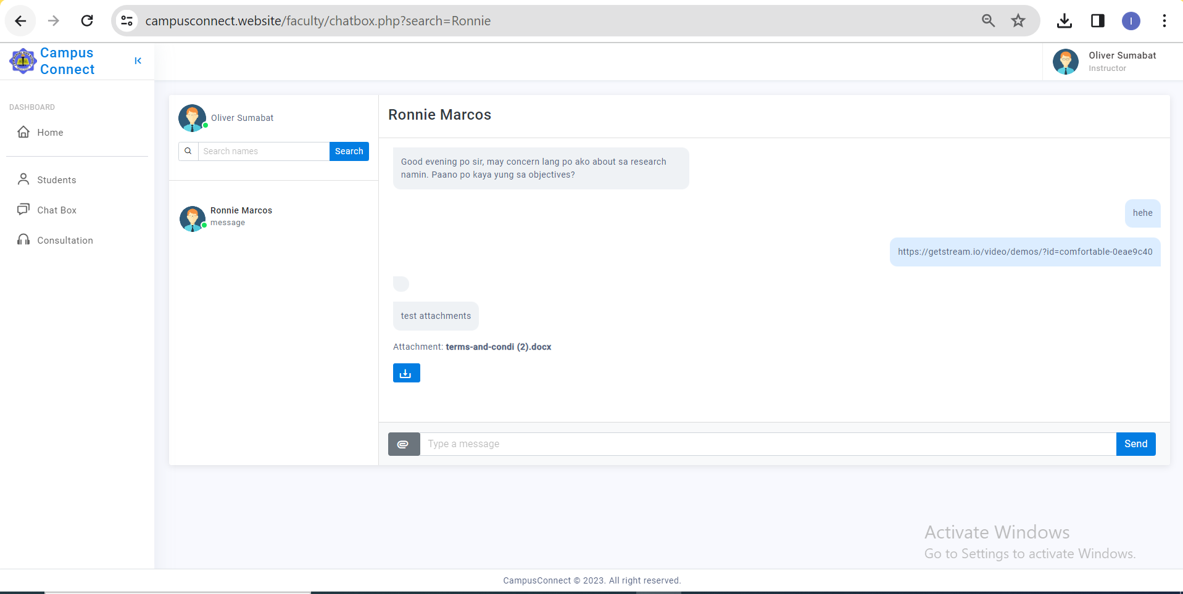
1.1.3 Set Appointment
1.1.3.1Virtual Chats or Meetings for Consultation
RECOMMENDATIONS
OBJECTIVES
RESULT AND DISCUSSION
CONCLUSION
METHODOLOGY
Campus Connect: A Web-based Platform for Monitoring Faculty-Student Engagement

Slide 12
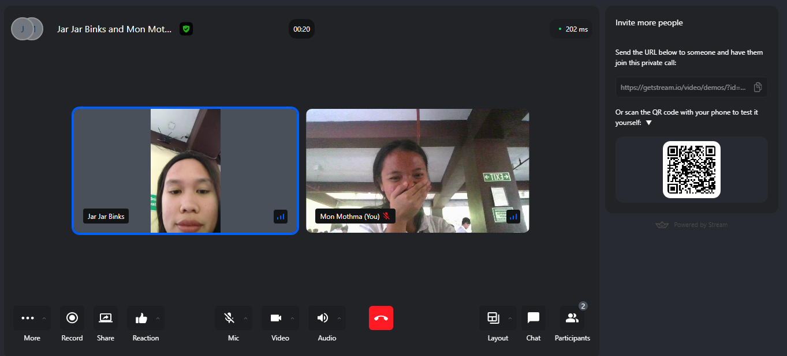
1.1.3 Set Appointment
1.1.3.1Virtual Chats or Meetings for Consultation
RECOMMENDATIONS
OBJECTIVES
RESULT AND DISCUSSION
CONCLUSION
METHODOLOGY
Campus Connect: A Web-based Platform for Monitoring Faculty-Student Engagement

Slide 13
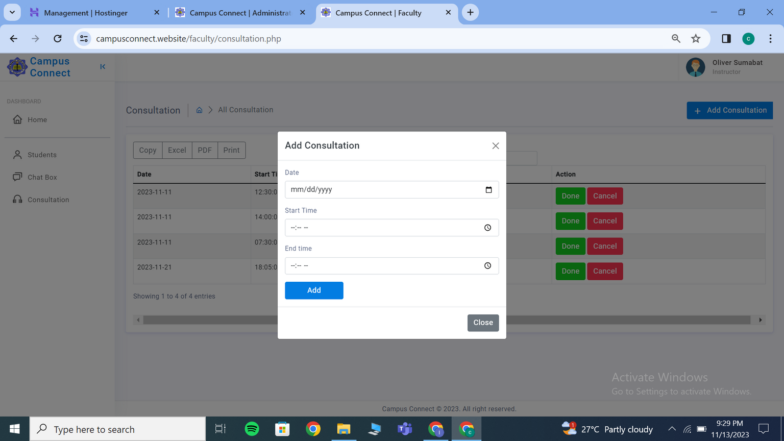
1.1.1.4Set Availability Status
RECOMMENDATIONS
OBJECTIVES
RESULT AND DISCUSSION
CONCLUSION
METHODOLOGY
Campus Connect: A Web-based Platform for Monitoring Faculty-Student Engagement

Slide 14
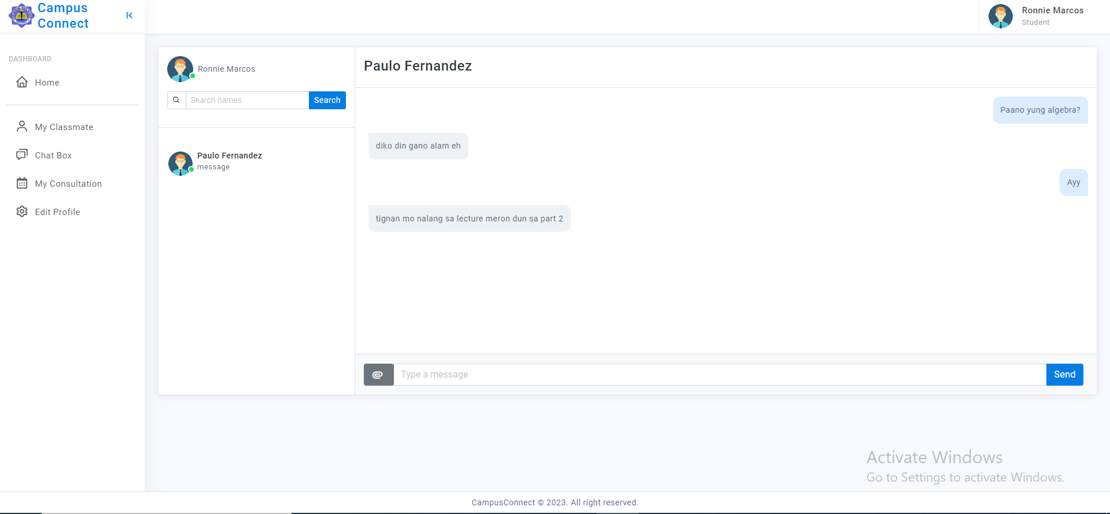
1.1.5Interactions Through Chat Box or Discussion Boards
RECOMMENDATIONS
OBJECTIVES
RESULT AND DISCUSSION
CONCLUSION
METHODOLOGY
Campus Connect: A Web-based Platform for Monitoring Faculty-Student Engagement

Slide 15
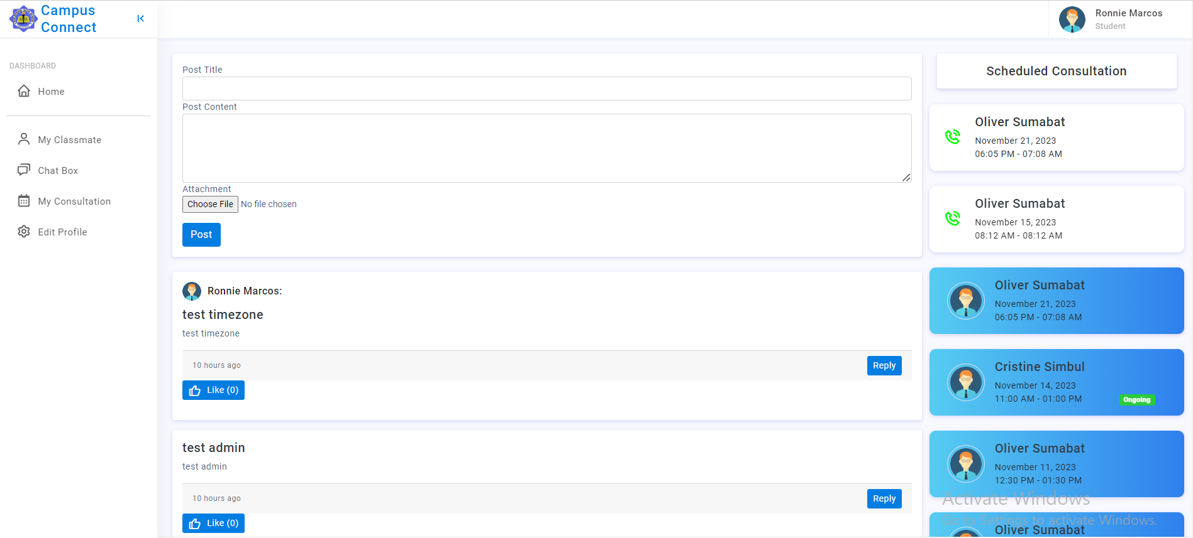
1.1.5Interactions Through Chat Box or Discussion Boards
RECOMMENDATIONS
OBJECTIVES
RESULT AND DISCUSSION
CONCLUSION
METHODOLOGY
Campus Connect: A Web-based Platform for Monitoring Faculty-Student Engagement

Slide 16
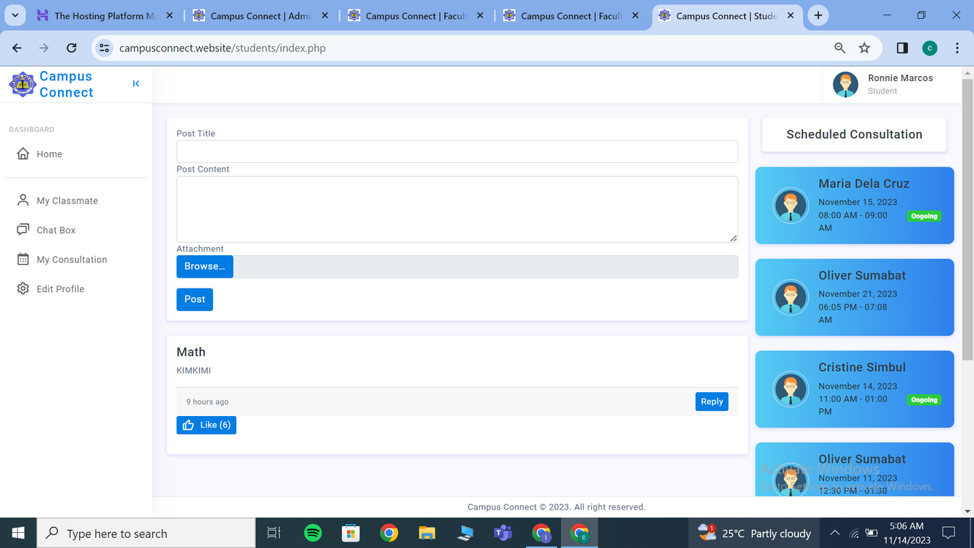
1.2Students Perspective
1.2.1Students’ Dashboard
RECOMMENDATIONS
OBJECTIVES
RESULT AND DISCUSSION
CONCLUSION
METHODOLOGY
Campus Connect: A Web-based Platform for Monitoring Faculty-Student Engagement

Slide 17
1.2.2Take Virtual Consultation or Meetings
RECOMMENDATIONS
OBJECTIVES
RESULT AND DISCUSSION
CONCLUSION
METHODOLOGY
Campus Connect: A Web-based Platform for Monitoring Faculty-Student Engagement

Slide 18
1.2.3Interactions Through Chat Box or Discussion Boards
RECOMMENDATIONS
OBJECTIVES
RESULT AND DISCUSSION
CONCLUSION
METHODOLOGY
Campus Connect: A Web-based Platform for Monitoring Faculty-Student Engagement

Slide 19
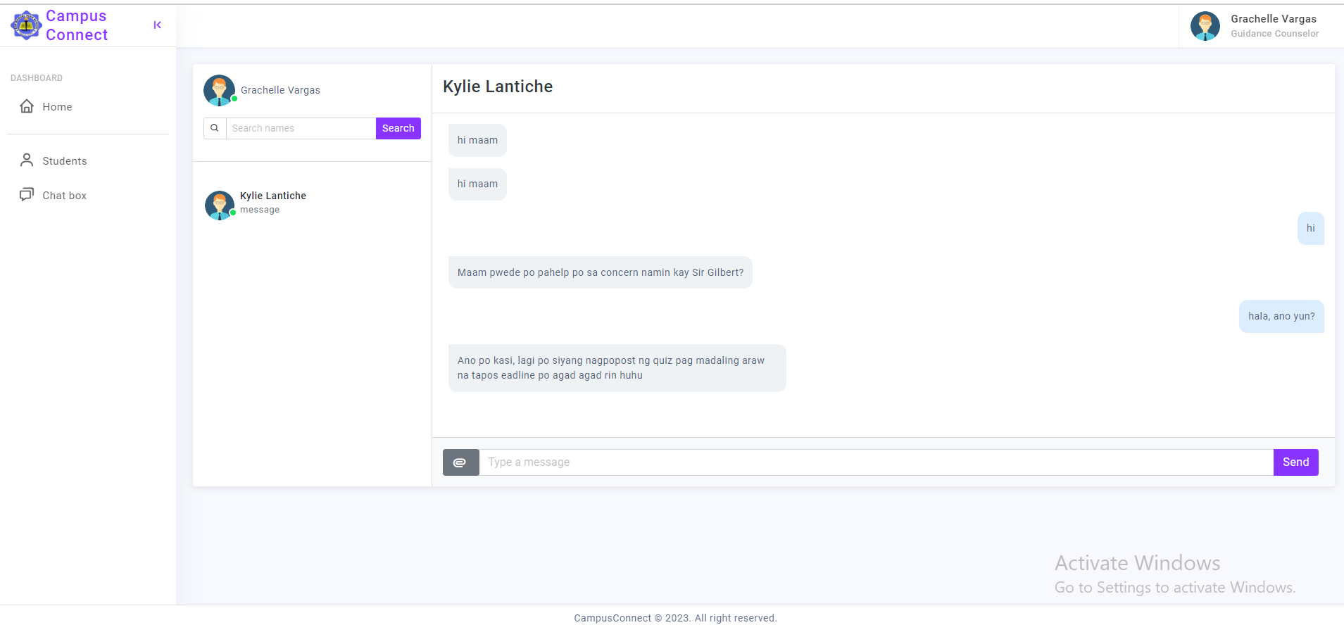
1.2.4Submit Concerns to the Guidance Counselor
RECOMMENDATIONS
OBJECTIVES
RESULT AND DISCUSSION
CONCLUSION
METHODOLOGY
Campus Connect: A Web-based Platform for Monitoring Faculty-Student Engagement

Slide 20
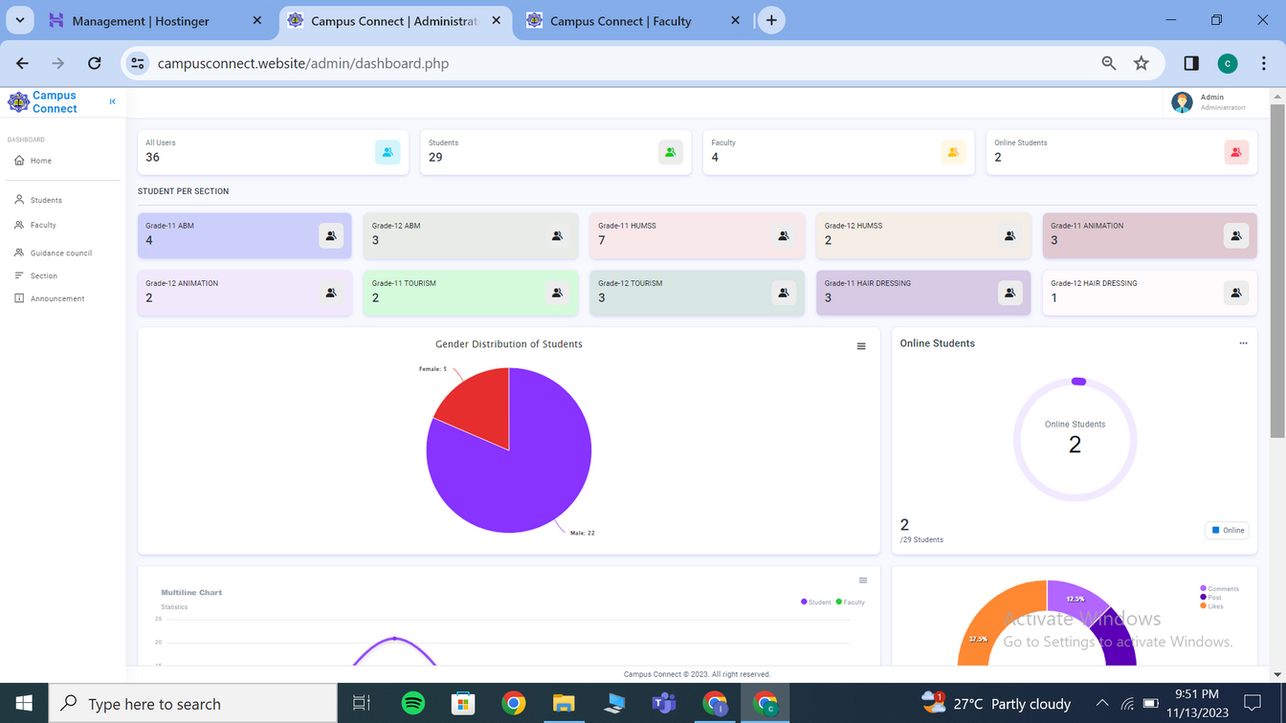
1.3 System Administrator Module
1.3.1 Manage System
RECOMMENDATIONS
OBJECTIVES
RESULT AND DISCUSSION
CONCLUSION
METHODOLOGY
Campus Connect: A Web-based Platform for Monitoring Faculty-Student Engagement

Slide 21
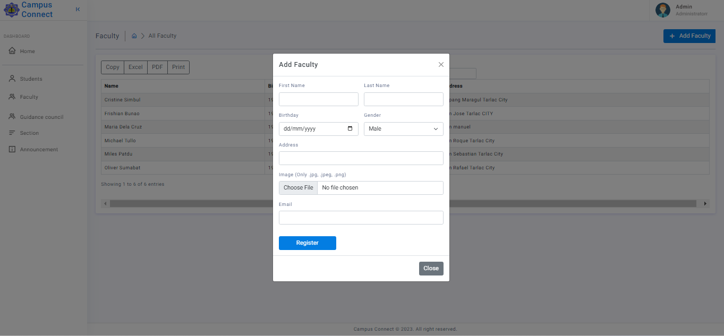
1.3.1.1 Create Instructors’ Dashboard
RECOMMENDATIONS
OBJECTIVES
RESULT AND DISCUSSION
CONCLUSION
METHODOLOGY
Campus Connect: A Web-based Platform for Monitoring Faculty-Student Engagement

Slide 22
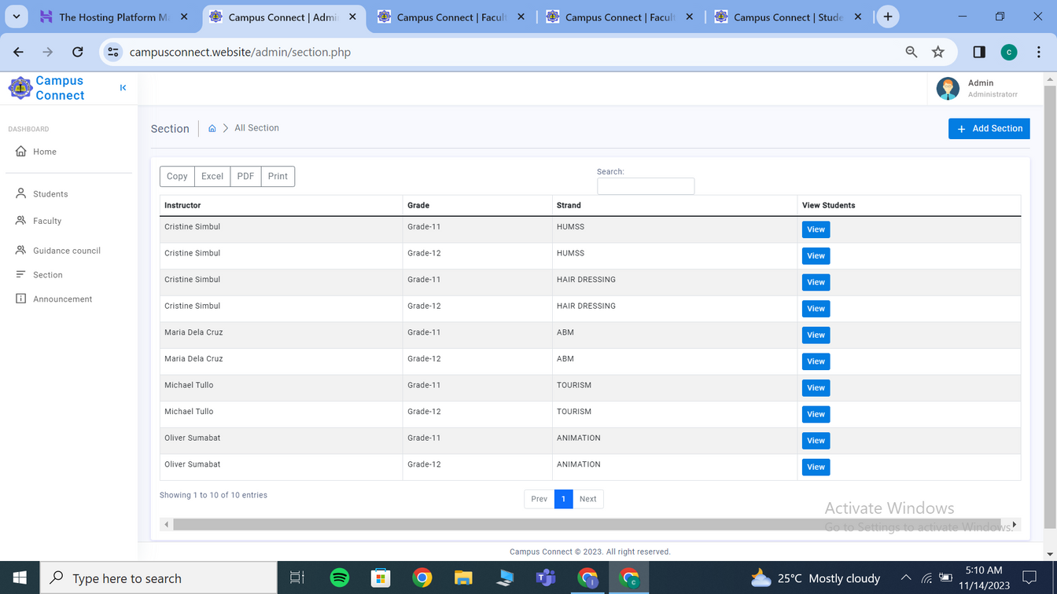
1.3.1.2 Manage the performance of the platform
RECOMMENDATIONS
OBJECTIVES
RESULT AND DISCUSSION
CONCLUSION
METHODOLOGY
Campus Connect: A Web-based Platform for Monitoring Faculty-Student Engagement

Slide 23
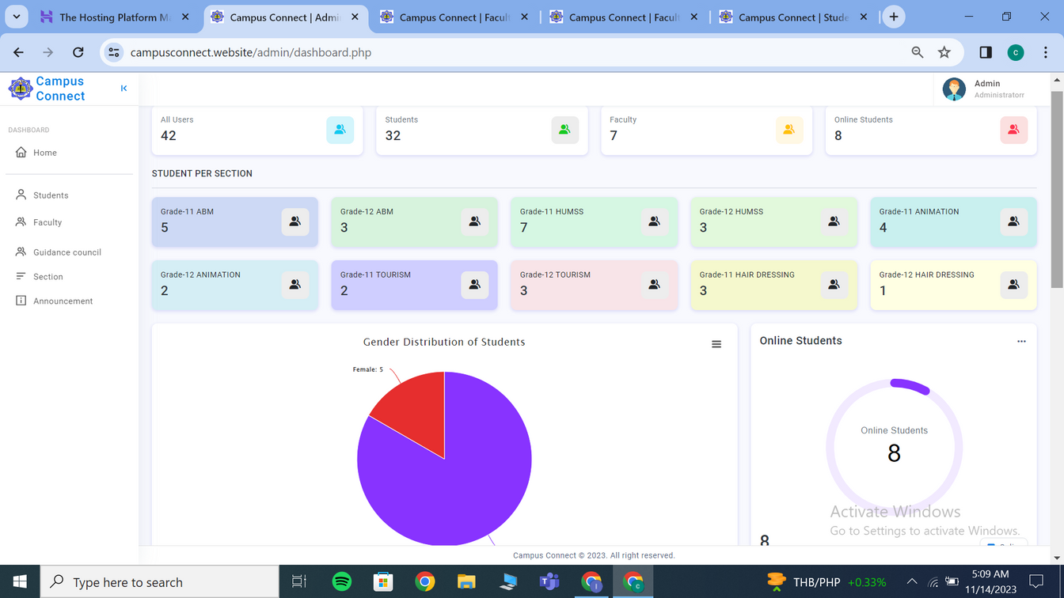
1.3.1.3 Monitoring Student engagement and Analytics
RECOMMENDATIONS
OBJECTIVES
RESULT AND DISCUSSION
CONCLUSION
METHODOLOGY
Campus Connect: A Web-based Platform for Monitoring Faculty-Student Engagement

Slide 24
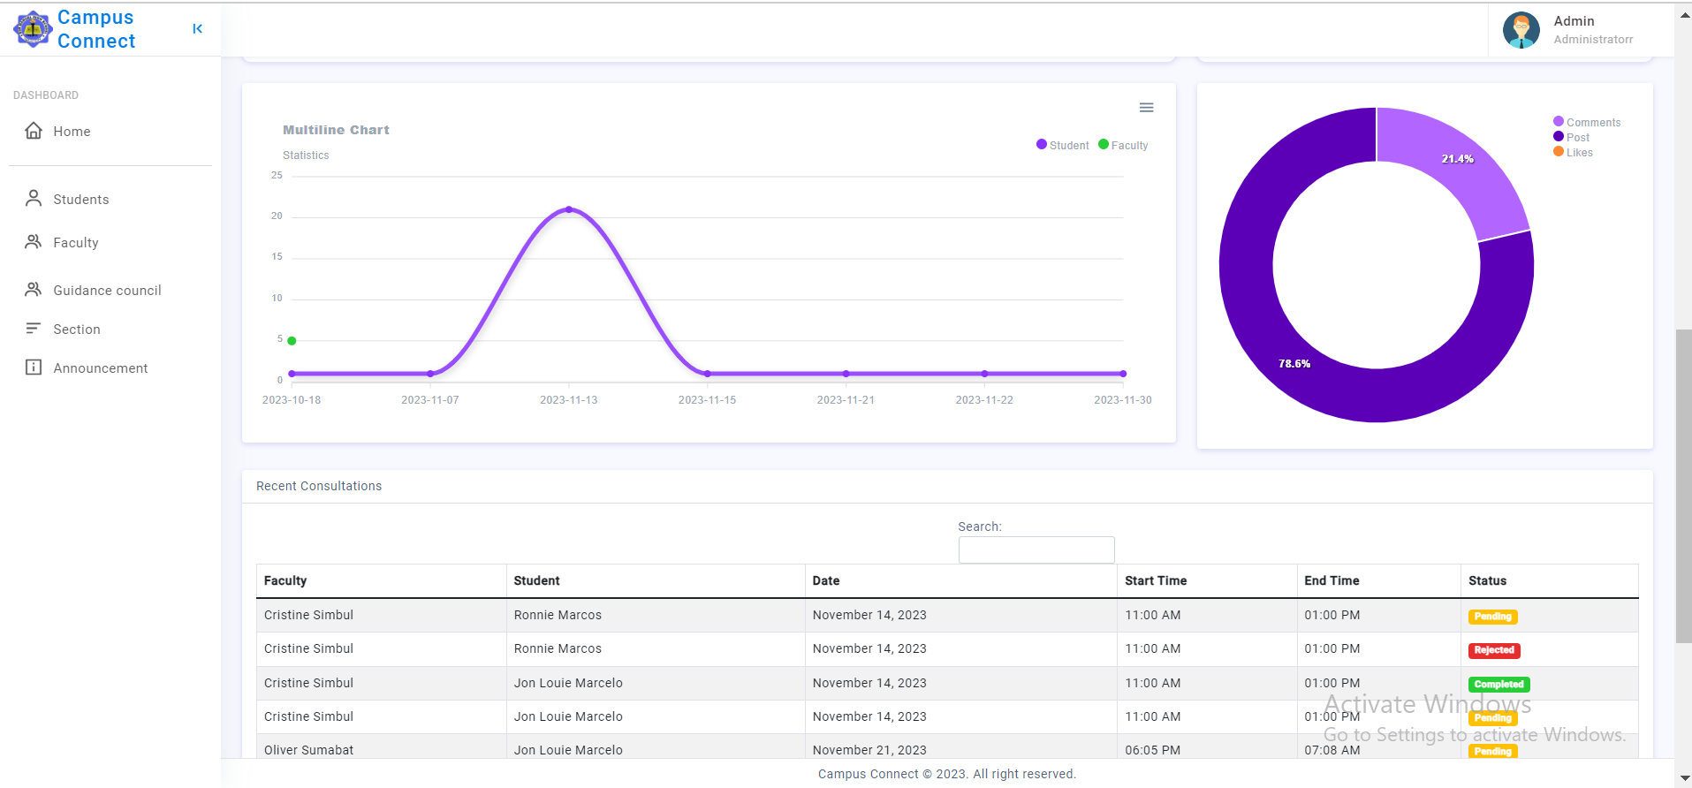
1.3.1.3 Monitoring Student engagement and Analytics
RECOMMENDATIONS
OBJECTIVES
RESULT AND DISCUSSION
CONCLUSION
METHODOLOGY
Campus Connect: A Web-based Platform for Monitoring Faculty-Student Engagement

Slide 25
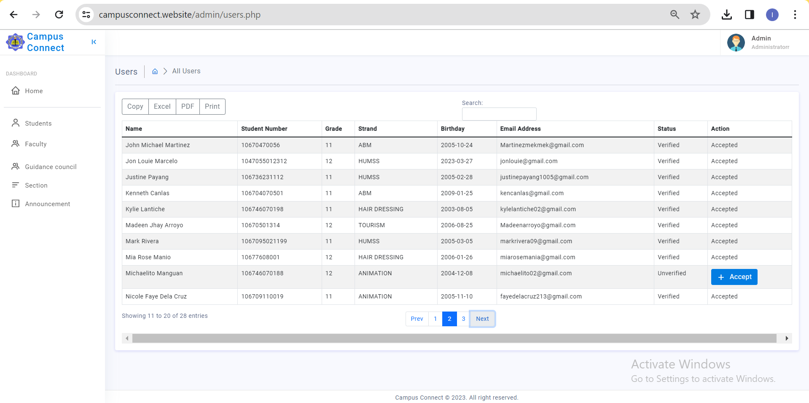
1.3.1.4 User Management
1.3.1.4.1Approval and Deletion of Account
RECOMMENDATIONS
OBJECTIVES
RESULT AND DISCUSSION
CONCLUSION
METHODOLOGY
Campus Connect: A Web-based Platform for Monitoring Faculty-Student Engagement

Slide 26
1.4 Guidance Counselor Module
1.4.1Manage Students concern
1.4.2Review submitted concerns (from the students)
RECOMMENDATIONS
OBJECTIVES
RESULT AND DISCUSSION
CONCLUSION
METHODOLOGY
Campus Connect: A Web-based Platform for Monitoring Faculty-Student Engagement

Slide 27
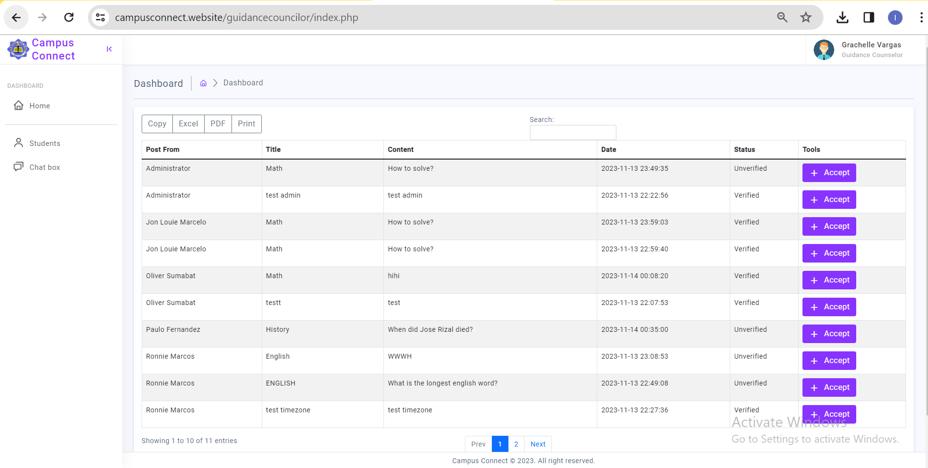
1.4.3Content Moderation ( accept or reject content)
RECOMMENDATIONS
OBJECTIVES
RESULT AND DISCUSSION
CONCLUSION
METHODOLOGY
Campus Connect: A Web-based Platform for Monitoring Faculty-Student Engagement

Slide 28

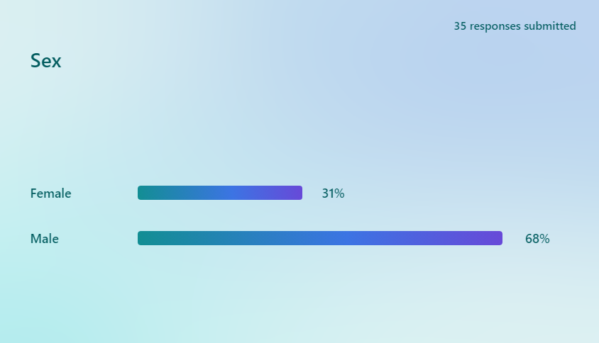
RECOMMENDATION
RESULT AND DISCUSSION
GENDER DISTRIBUTION
OBJECTIVES
RESULT & DISCUSION
CONCLUSION
METHODOLOGY
Campus Connect: A Web-based Platform for Monitoring Faculty-Student Engagement

Slide 29
RECOMMENDATION
RESULT AND DISCUSSION
Students Section
Others (Faculty, Principal, Guidance Counselor and
IT Experts)
OBJECTIVES
11 and 12 HUMSS: 7
11 and 12 ABM: 7
11 and 12 Animation: 5
11 and 12 Hairdressing: 4
11 and 12 Tourism: 6
IT Experts: 3
Faculty: 2
Principal: 1
RESULT & DISCUSION
CONCLUSION
METHODOLOGY
Campus Connect: A Web-based Platform for Monitoring Faculty-Student Engagement

Slide 30
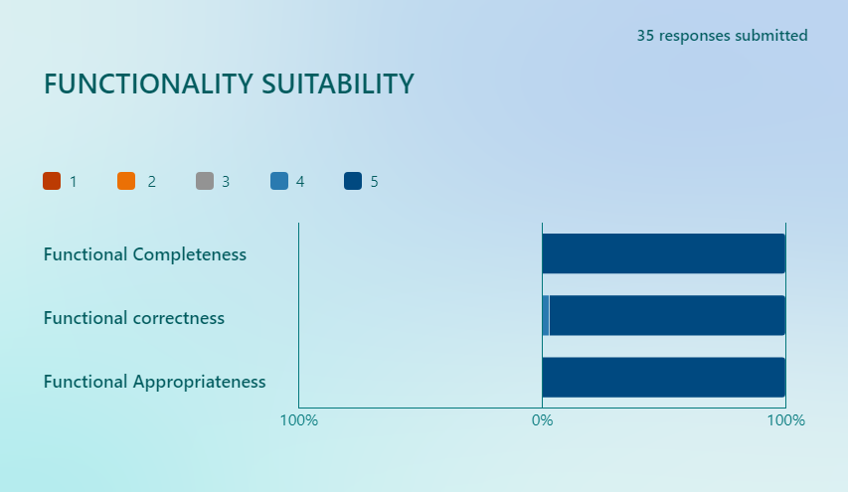
RECOMMENDATION
RESULT AND DISCUSSION
Rating of the system’s functionality suitability
by 35 users
OBJECTIVES
Functional Completeness: 5
(PASSED)
Functional Correctness: 4.9
(PASSED)
Functional Appropriateness: 5
(PASSED)
RESULT & DISCUSION
CONCLUSION
Total: 4.9 (PASSED)
METHODOLOGY
Campus Connect: A Web-based Platform for Monitoring Faculty-Student Engagement

Slide 31
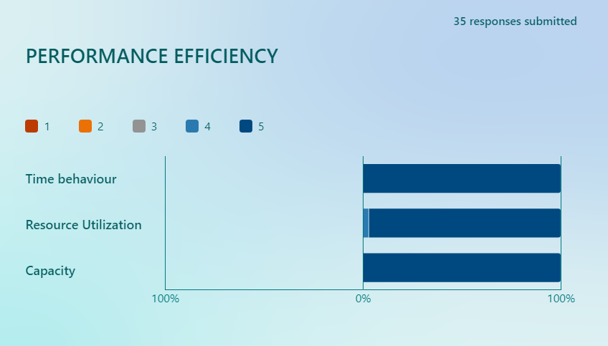
RECOMMENDATION
RESULT AND DISCUSSION
Rating of the system’s performance efficiency
by 35 users
OBJECTIVES
RESULT & DISCUSION
Time behavior: 5
(PASSED)
Resource Utilization: 4.9
(PASSED)
Capacity: 5
(PASSED)
CONCLUSION
Total: 4.9 (PASSED)
RECOMMENDATION FOR FUTURE RESEARCHER
Campus Connect: A Web-based Platform for Monitoring Faculty-Student Engagement

Slide 32
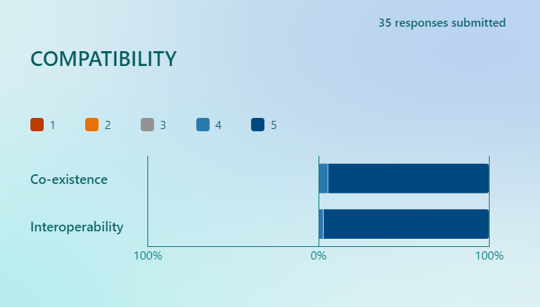
RECOMMENDATION
RESULT AND DISCUSSION
Rating of the system’s compatibility by 35 users
OBJECTIVES
RESULT & DISCUSION
Co-existence: 4.8
(PASSED)
Interoperability: 4.9
(PASSED)
CONCLUSION
Total: 4.8 (PASSED)
RECOMMENDATION FOR FUTURE RESEARCHER
Campus Connect: A Web-based Platform for Monitoring Faculty-Student Engagement

Slide 33
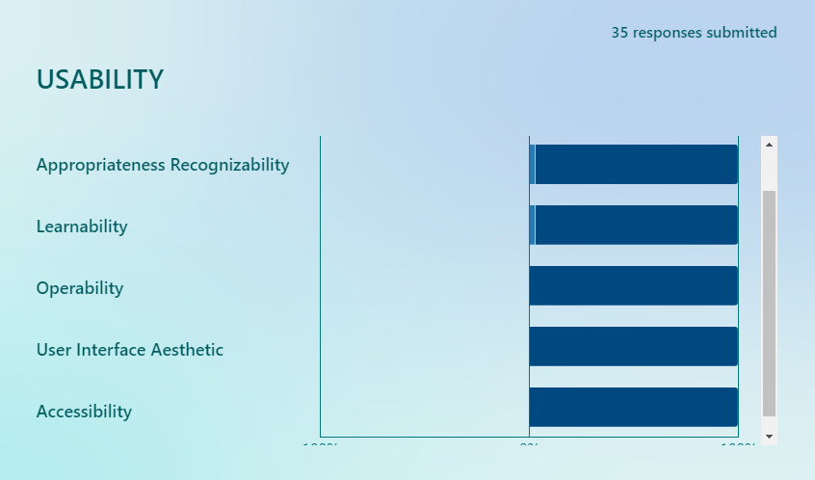
RECOMMENDATION
RESULT AND DISCUSSION
Rating of the system’s functionality usability by
35 users
OBJECTIVES
Appropriateness
Recognizability: 4.9
(PASSED)
Learnability: 4.9
(PASSED)
Operability: 5
(PASSED)
User Interface Aesthetic: 5
(PASSED)
Accessibility: 5
(PASSED)
RESULT & DISCUSION
CONCLUSION
RECOMMENDATION FOR FUTURE RESEARCHER
Total: 4.9 (PASSED)
Campus Connect: A Web-based Platform for Monitoring Faculty-Student Engagement

Slide 34
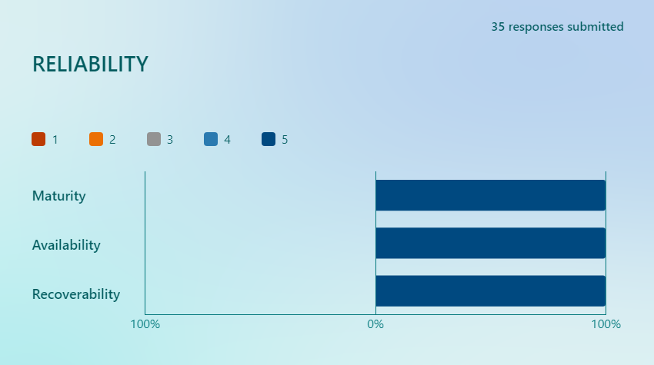
RECOMMENDATION
RESULT AND DISCUSSION
Rating of the system’s reliability by 35 users
OBJECTIVES
Maturity: 5
(PASSED)
Availability: 5
(PASSED)
Recoverability: 5
(PASSED)
RESULT & DISCUSION
CONCLUSION
Total: 5 (PASSED)
RECOMMENDATION FOR FUTURE RESEARCHER
Campus Connect: A Web-based Platform for Monitoring Faculty-Student Engagement

Slide 35
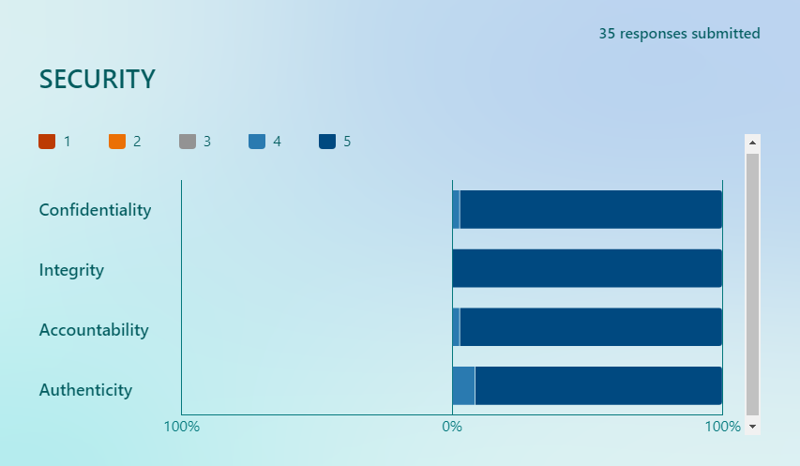
RECOMMENDATIO
RESULT AND DISCUSSION
Rating of the system’s security by 35 users
OBJECTIVES
Confidentiality: 4.9
(PASSED)
Integrity: 5
(PASSED)
Accountability: 4.9
(PASSED)
Authenticity: 4.7
(PASSED)
RESULT & DISCUSION
CONCLUSION
Total: 4.8 (PASSED)
RECOMMENDATION FOR FUTURE RESEARCHER
Campus Connect: A Web-based Platform for Monitoring Faculty-Student Engagement

Slide 36
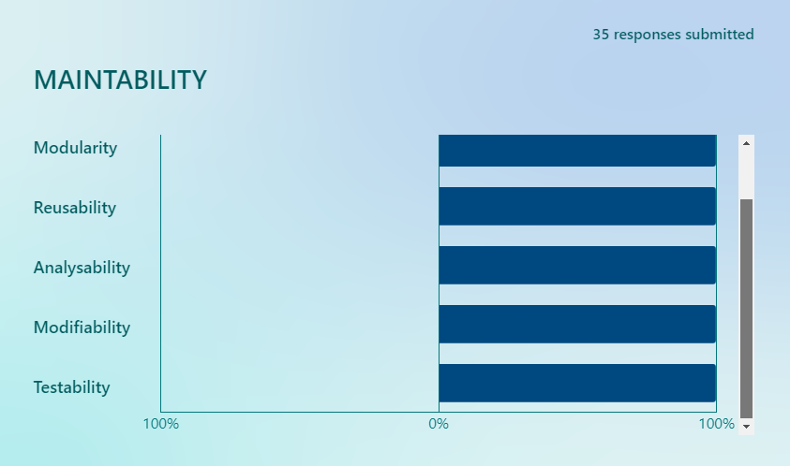
RECOMMENDATION
RESULT AND DISCUSSION
Rating of the system’s maintability by 35 users
OBJECTIVES
Modularity: 5
(PASSED)
Reusability: 5
(PASSED)
Analysability: 5
(PASSED)
Modifiability: 5
(PASSED)
Testability: 5
(PASSED)
RESULT & DISCUSION
CONCLUSION
RECOMMENDATION FOR FUTURE RESEARCHER
Total: 5 (PASSED)
Campus Connect: A Web-based Platform for Monitoring Faculty-Student Engagement

Slide 37
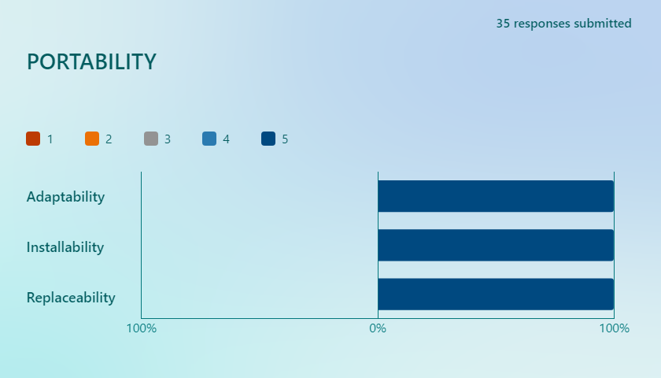
RECOMMENDATION
RESULT AND DISCUSSION
RATING OF THE SYSTEM’S PORTABILITY BY 35 USERS
OBJECTIVES
Adaptability: 5
(PASSED)
Installability: 5
(PASSED)
Replaceability: 5
(PASSED)
RESULT & DISCUSION
CONCLUSION
Total: 5 (PASSED)
RECOMMENDATION FOR FUTURE RESEARCHER
Campus Connect: A Web-based Platform for Monitoring Faculty-Student Engagement

Slide 38
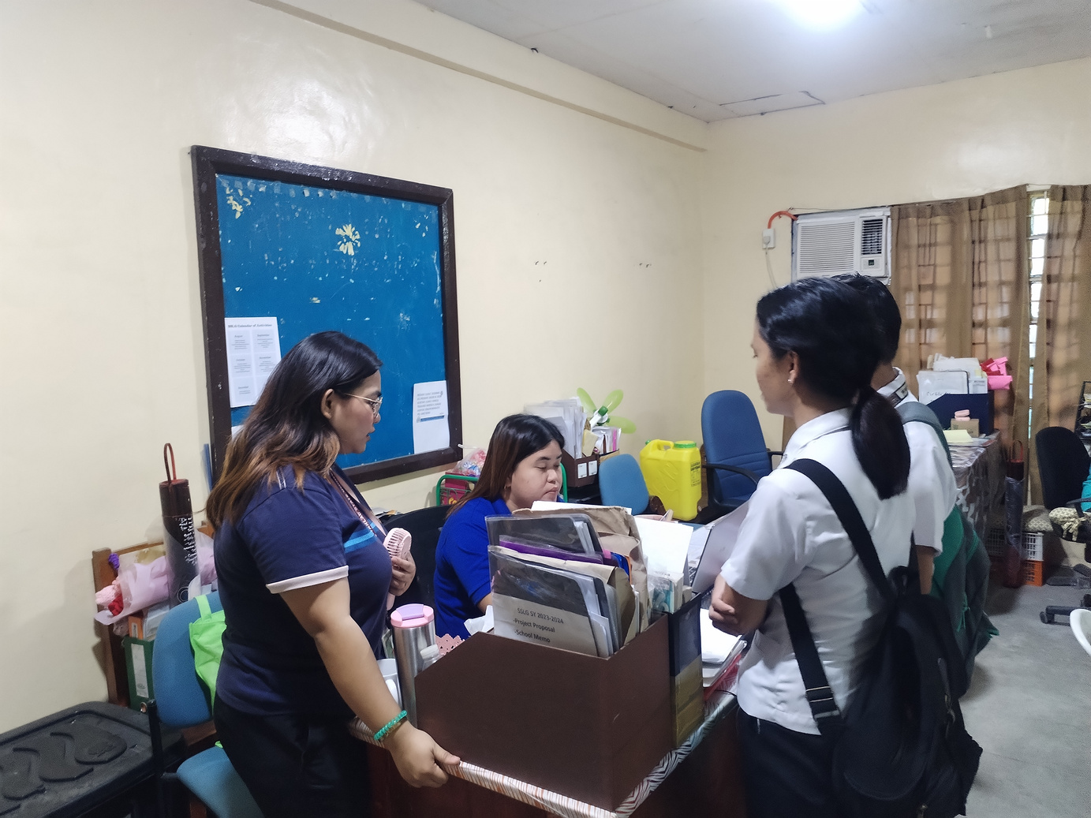
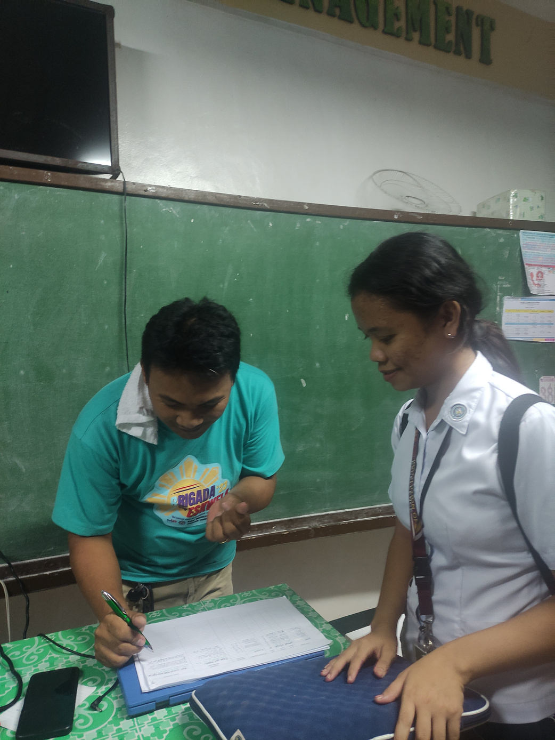
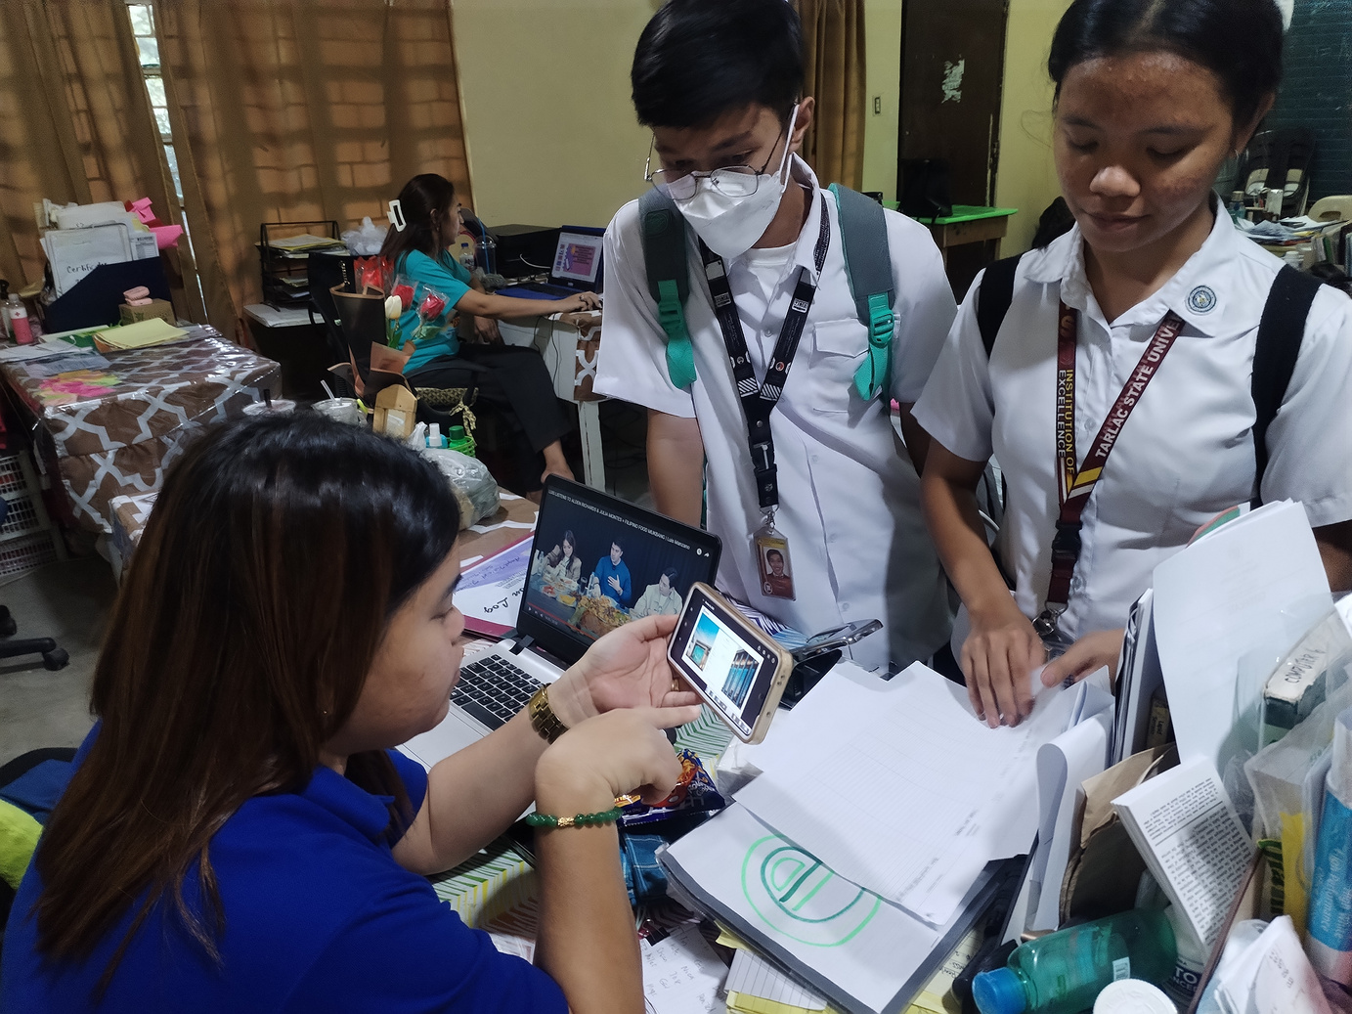
RECOMMENDATION
OBJECTIVES
RESULT & DISCUSION
CONCLUSION
RECOMMENDATION FOR FUTURE RESEARCHER
Campus Connect: A Web-based Platform for Monitoring Faculty-Student Engagement

Slide 39
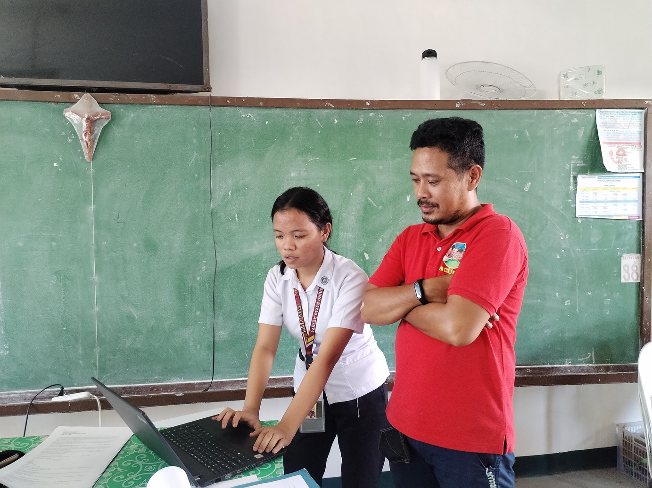
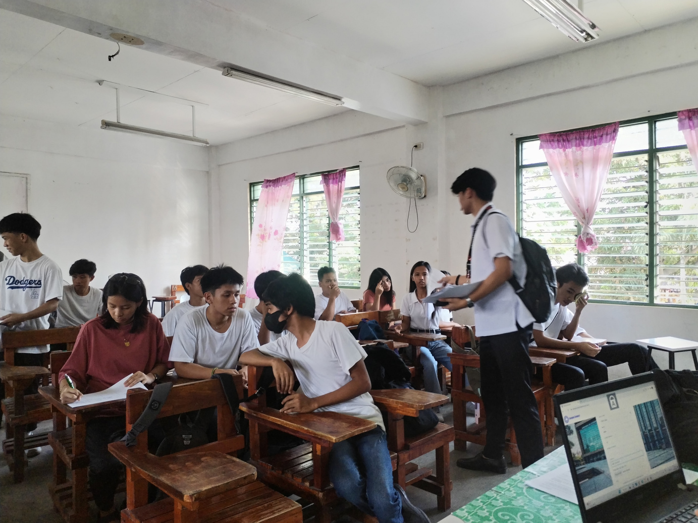
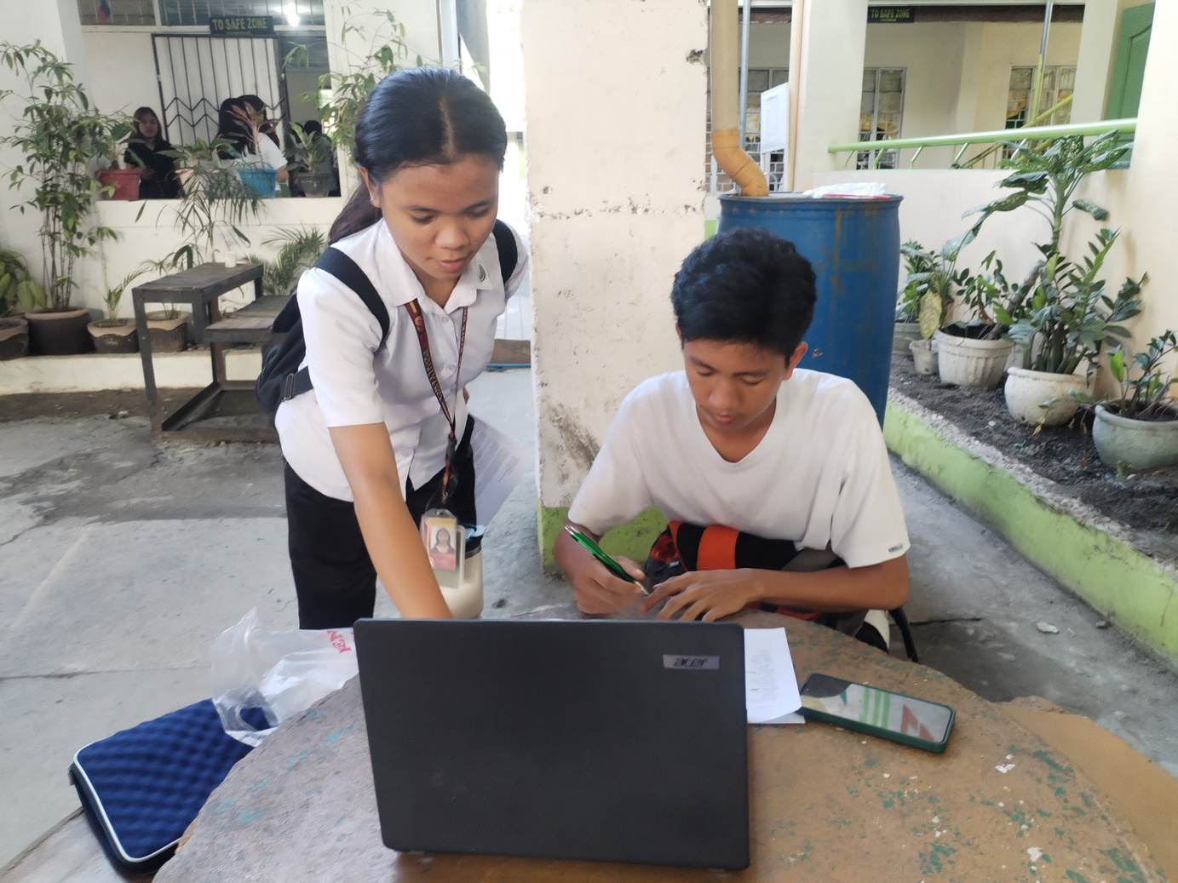
RECOMMENDATION
RESULT & DISCUSION
OBJECTIVES
RESULT & DISCUSION
CONCLUSION
RECOMMENDATION FOR FUTURE RESEARCHER
Campus Connect: A Web-based Platform for Monitoring Faculty-Student Engagement

Slide 40
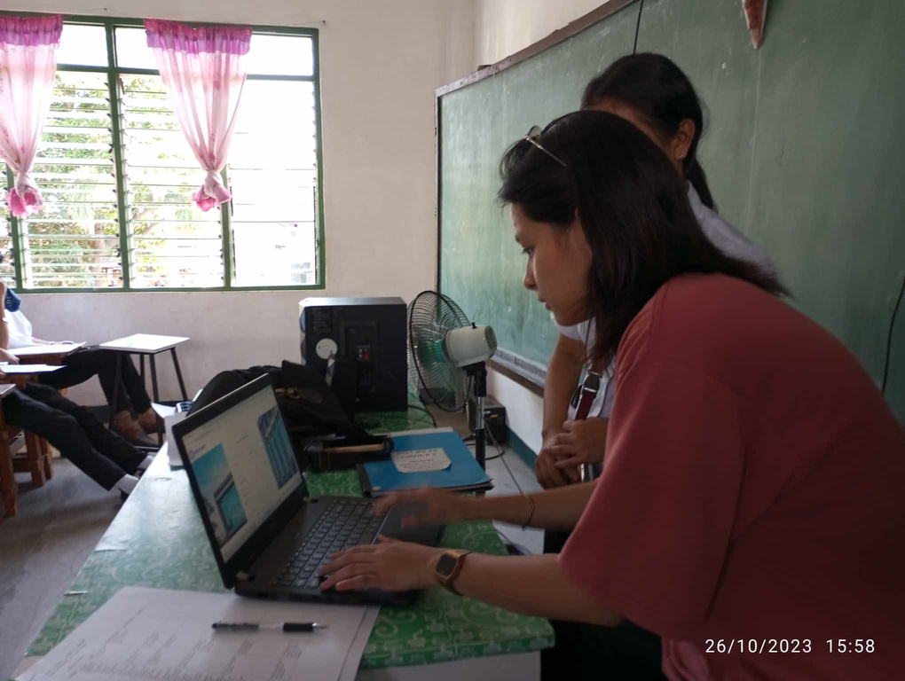
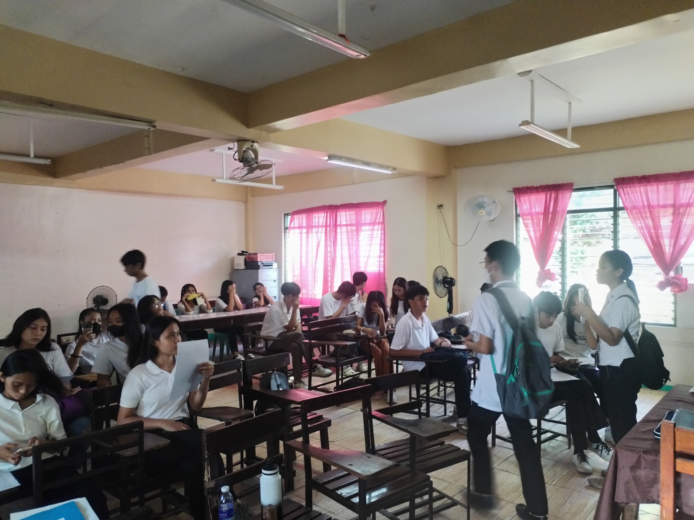
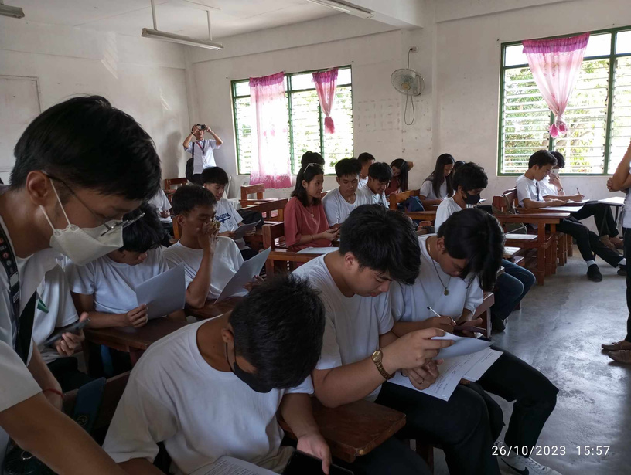

RECOMMENDATION
RESULT & DISCUSION
OBJECTIVES
RESULT & DISCUSION
CONCLUSION
RECOMMENDATION FOR FUTURE RESEARCHER
Campus Connect: A Web-based Platform for Monitoring Faculty-Student Engagement

Slide 41
RECOMMENDATION
OBJECTIVES
CONCLUSION
The researcher were able to develop the following features of “Campus Connect: A Web-based Platform for Monitoring Faculty-Student Engagement”
RESULT AND DISCUSSION
CONCLUSION
RECOMMENDATION FOR FUTURE RESEARCHER
Campus Connect: A Web-based Platform for Monitoring Faculty-Student Engagement

Slide 42
1.1 Instructor Module
1.3 System Administrator Module
1.1.1Instructors’ Dashboard
1.1.2Manage Students Consultation
1.1.3Set Appointment
1.1.3.1 Virtual Chats or Meetings for Consultation
1.1.4Set Availability Status
1.1.5Interactions Through Chat Box or Discussion Boards
RECOMMENDATION
1.3.1 Manage System
1.3.1.1 Create Instructors’ Dashboard
1.3.1.2 Manage the performance of the platform
1.3.1.3 Monitoring Student engagement and Analytics
1.3.1.4 User Management
1.3.1.4.1Approval and Deletion of Account
OBJECTIVES
RESULT AND DISCUSSION
1.2 Student Module
1.2.1Students’ Dashboard
1.2.2Take Virtual Consultation or Meetings
1.2.3Interactions Through Chat Box or Discussion Boards
1.2.4Submit Concerns to the Admin
1.4 Guidance Counselor Module
CONCLUSION
1.4.1Manage Students concern
1.4.2Review submitted concerns (from the students)
1.4.3Content Moderation ( accept or reject content)
RECOMMENDATION FOR FUTURE RESEARCHER
Campus Connect: A Web-based Platform for Monitoring Faculty-Student Engagement

Slide 43
RECOMMENDATION
CONCLUSION
The researcher achieved a positive result in assessing the functional suitability, performance efficiency, compatibility, usability, reliability, security, maintability and portability of the system.
OBJECTIVES
Functionality Suitability:
Performance Efficiency:
Compatibility:
Usability:
Reliability:
Security:
Maintability:
Portability:
4.9 (PASSED)
4.9 (PASSED)
4.8 (PASSED)
4.9 (PASSED)
5 (PASSED)
4.8 (PASSED)
5 (PASSED)
5 (PASSED)
RESULT AND DISCUSSION
CONCLUSION
RECOMMENDATION FOR FUTURE RESEARCHER
Campus Connect: A Web-based Platform for Monitoring Faculty-Student Engagement

Slide 44
RECOMMENDATION
RECOMMENDATION
The researchers considering the potential for future researchers to explore the development of a mobile application with similar functionality.
The researchers suggests that the user is capable of receiving notifications from the system.
The researchers suggest that future researchers should enhance the security of the system.
OBJECTIVES
RESULT AND DISCUSSION
CONCLUSION
RECOMMENDATION FOR FUTURE RESEARCHER
Campus Connect: A Web-based Platform for Monitoring Faculty-Student Engagement

